Slide 1
Welcome to CS 235
1170 TMCB
Dr. Tom Stephens

Slide 2
Today
Introduction to C++
Data types
Basic I/O
Next Time
Functions
Future
Notes:
You’ll see this slide a lot.
What majors do we have?
Why are you taking the class?

Slide 3


Slide 4
Why C++?
As a “mid-level” language, it helps you understand how computers work – e.g. strong variable types, pointers, memory management, etc.
It makes you a better developer – It’s not the easiest language and helps you develop skills in writing good, clean code
Mastering C++ guarantees required experience to master almost any other programming language
The list goes on and on … - for some other examples read https://levelup.gitconnected.com/want-to-be-a-software-developer-learn-c-first-and-thank-me-later-30a447f32037

Slide 5
Why C++?
No one says you should code some website’s front-end with C++. It’s your choice, but remember this,
JavaScript runs on an engine written in C/C++ (e.g. Google V8),
.NET Framework CLR is written in C++,
MS Windows is written in C/C++.
Apple OS X is written in C/C++.
Java JVM is written in C++,
MongoDB, Redis, web-browsers, Linux, MySQL, Adobe Photoshop, Illustrator, Nginx, OS X are written in a mix of languages, but a few important parts are C++,
Google internal/external products (including Google Search), Microsoft Visual Studio, even C# compiler itself is written in C++.

Slide 6
Some Resources
Computer Science Research Guide – on the library website
Especially the Web Resources tab’s Tutorials section
Stack Overflow – https://stackoverflow.com
Programming Q&A site
Most of your questions have already been answered – use the search feature
Don’t post homework problems as questions – they sniff those out pretty quick
GitHub – https://www.github.com
Code repository for backing up work
Make your repositories for homework private!

Slide 7
Compiled vs. Interpreted Code
Compiled = fast but not portable
Runs on bare hardware-–instructions are not interpreted at runtime
Recompile (and often re-code and then recompile) to run on different hardware
Interpreted = slow but portable
Runs on a VM or interpreter that interprets and translates instructions at runtime
Runs on any platform with an interpreter without recompiling

Slide 8
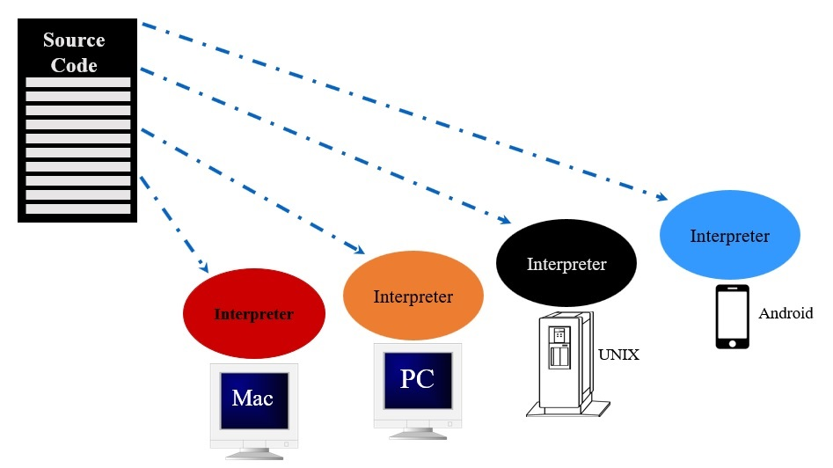
Interpreted Code

Slide 9
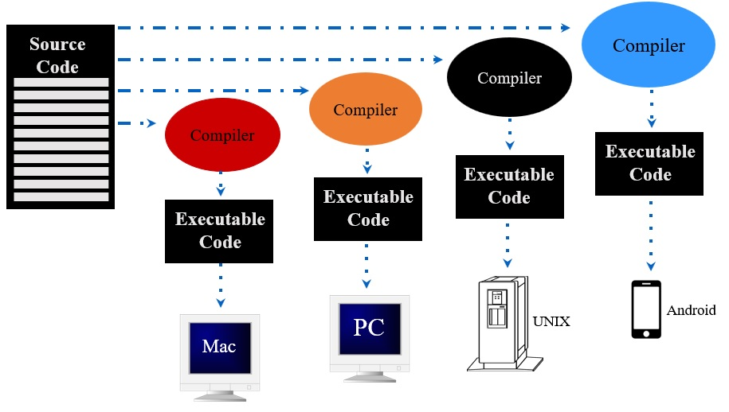
Compiled Code

Slide 10
What is a Compiler?
A computer program that takes source code and converts it into instructions a computer can execute
01000010‬‭01110010‬‭01100101‬‭01110100‬‭01110100
10101010010011110100
11010100101101000101010101011010101000100101010010101101101010000101110110100010000010010101101010010001001111001010011010100110110110110001
‭01000010‬‭01110010‬‭01100101‬‭01110100‬‭01110100‬
#include <iostream>
using namespace std;
int main() {
cout << “Hello World!” << endl;
return 0; }
Compiler
Source Code
Executable Code

Slide 11
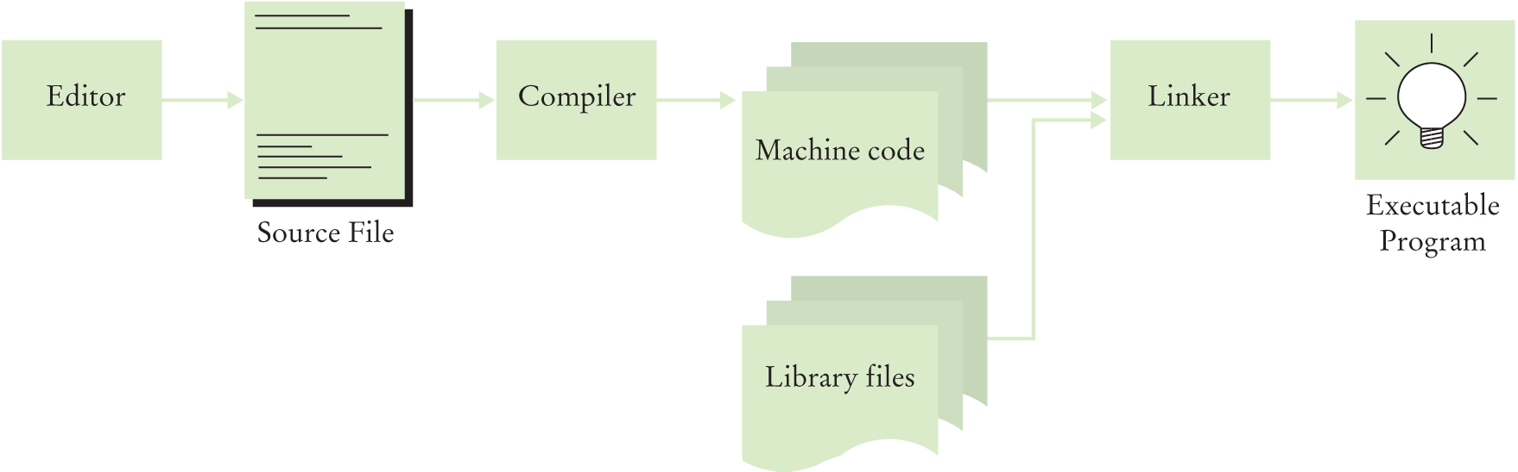
C++ toolchain
The compiler translates C++ programs into machine code
The linker combines machine code with library code into an executable program.

Slide 12
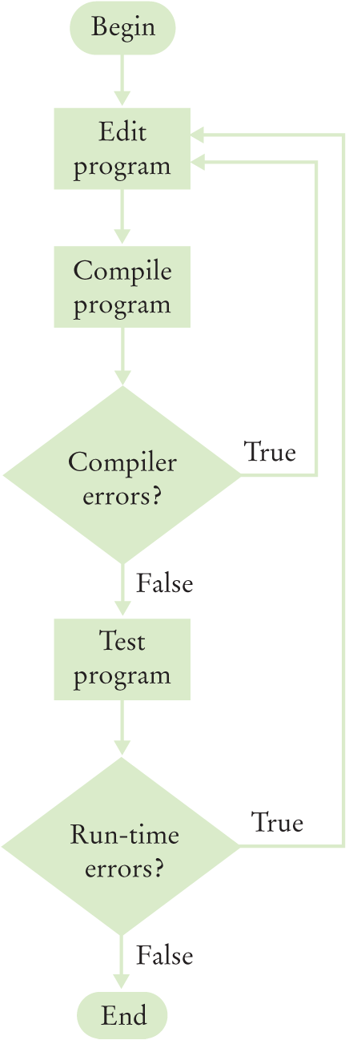
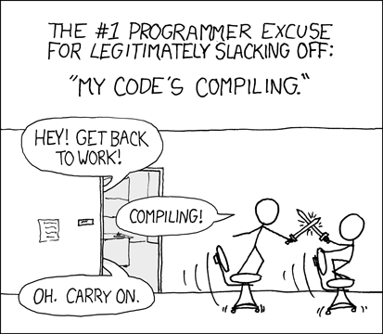
The Programmer’s Inner Loop
This process reflects the way programmers work
(shown as a flowchart)
https://xkcd.com/303
C++ for Everyone by Cay Horstmann
Copyright © 2012 by John Wiley & Sons. All rights reserved

Slide 13
Questions?

Slide 14
our First C++ Program
#include <iostream>
using namespace std;
int main (int argc, char* argv[]){
cout << “Hello world!” << endl;
return 0;
}

Slide 15
Whitespace
The C++ compiler ignores almost all whitespace
Important whitespace
Inside strings
Around keywords and function/variable names
Newlines after preprocessor directives
Everything else doesn’t matter
That said, we want our code to be readable
This is perfectly valid c++
#include <iosteam>
using namespace std;int main(){cout<<“Hello world.”<<endl; return 0;}
But it’s not good style

Slide 16
Braces & Semicolons
In Python whitespace and indentation delimit lines and blocks of code
But whitespace doesn’t matter in C++; we need something else
Statements are terminated by semicolons (;) – think of them as periods at the end of sentences
Blocks of code are enclosed by braces ({})
often called curly braces
These serve the same purpose as indentation levels in Python

Slide 17
Brace Styles
Brace placement | Style
while (x == y) { something(); somethingelse(); } | K&R
Brace placement | Style
while (x == y) { something(); somethingelse(); } | Horstmann
while (x == y) { something(); somethingelse(); } | Allman
while (x == y) { something(); somethingelse(); } | Pico
while (x == y) { something(); somethingelse(); } | GNU
while (x == y) { something(); somethingelse(); } | Ratliff
while (x == y) { something(); somethingelse(); } | Whitesmiths
while (x == y) { something(); somethingelse(); } | Lisp

Slide 19
C++ is a Typed language
Variables can hold any kind of information but in C++ we need to let the compiler know what type of information any given variable will hold – this is the type.
You can think of types as a primitive data structure
The type tells the compiler how to interpret the lower-level data (bits) into a higher-level construct.

Slide 20
The primitive Data Types
C++ has eight primitive data types:
Integers
short (16 bits)
int (32 bits)
long (32 bits)
long long (64 bits)
Characters
char (8 bits)
Floating point numbers
float (32 bits)
double (64 bits)
Boolean
Bool (1 bit)

Slide 21
Declaring Variables
When we want to use a variable, we need to tell the compiler two things – its name and what type of data we want it to store
int numStudents;
This statement creates a variable named numStudents that can hold integer values (the int part)
variable type
variable name

Slide 22
Assigning data to variables
x = 5;
This is an assignment statement we are assigning the value 5 to the variable x
The ‘=‘ is called the assignment operator in C++
It is not the mathematical equality symbol – that is ‘==‘
We can use a variable on both sides of the assignment statement like
x = x + 3;

Slide 23
Floating Point Data Types
Declaration | Size | Supported number range
float x; | 32 bits | -3.4x10³⁸ to 3.4x10³⁸
double x; | 64 bits | -1.7x10³⁰⁸ to 1.7x10³⁰⁸

Slide 24
Integer Data Types
Declaration | Size | Supported number range | Standard-defined minimum size
char myVar; | 8 bits | -128 to 127 | 8 bits
short myVar; | 16 bits | -32,768 to 32,767 | 16 bits
long myVar; | 32 bits | -2,147,483,648 to 2,147,483,647 | 32 bits
long long myVar; | 64 bits | -9,223,372,036,854,775,808 to 9,223,372,036,854,775,807 | 64 bits
int myVar; | 32 bits | -2,147,483,648 to 2,147,483,647 | 16 bits

Slide 25
Unsigned Integers
If we know we will never have negative numbers, we can double the maximum range of an integer by declaring it to be “unsigned”
Declaration | Size | Supported number range | Standard-defined minimum size
unsigned char myVar; | 8 bits | 0 to 255 | 8 bits
unsigned short myVar; | 16 bits | 0 to 65,535 | 16 bits
unsigned long myVar; | 32 bits | 0 to 4,294,967,295 | 32 bits
unsigned long long myVar; | 64 bits | 0 to 18,446,744,073,709,551,615 | 64 bits
unsigned int myVar; | 32 bits | 0 to 4,294,967,295 | 16 bits

Slide 26
Overflow
If you try to store a number that is larger than the maximum value a data type can hold, we have an overfloat
For floating point types, we just get infinity
For integers, the value wraps around into the negative values
The compiler might give you a warning if trying to assign the value from a larger data type into a smaller one.

Slide 27
Constants
Sometimes we have a number that we want to set and know it will never change.
To do that we put the const keyword in front of the initialization statement:
const double costPerSlice = 1.57;
But we want our constants to stand out, so we use a different naming style
const double COST_PER_SLICE = 1.57;
We normally define constants at the top of the file

Slide 28
Integer Division
When you use the division operator on two integers, you get the whole number of times the divisor goes into the dividend
10/3 = 3, not 3.3333333
3/4 = 0, not .75
This is what the floor division operator (//) in Python does
If you want to know what the remainder is, use the modulo operator (%)
10 % 3 = 1
3 % 4 = 3
Notes:
Go to Clion and do some examples

Slide 29
STrings
Strings are not a primitive type like int, double, and char
To use strings you need to #include <string>
after that, they act just like any other data type
String literals are surrounded by double quotes (quotation marks)
string myString = “Hello BYU!”

Slide 30
Arrays

Slide 31
Declaring arrays
To declare an array, we use the following syntax
dataType arrayName[numElements];
dataType is the type of data we want the array to hold (int, double, string, etc.)
arrayName can be any valid variable name
numElements has to be a constant integer value – either a constant variable or a literal

Slide 32
Accessing Arrays
To access an element of the array we give the variable name followed by the index in brackets
arrayName[index]
Indices in C++ start at 0 and must by an integer type
They can also be expressions as long as they evaluate to an integer (casting doesn’t count here)
We can use a variable – e.g. index
Or a more complicated expression – e.g. i+k-3

Slide 33
Array initialization
Just like other variables, arrays are NOT initialized when they are created – that is up to you as the programmer
If we know the values the array is going to have, we can initialize it like any other variable at its declaration using the following syntax:
dataType arrayName[numElements] = { value1, value2, …};
Or we can initialize the values using a loop
Like other variables, arrays can be declared const, and cannot be changed later – we need to use the first initialization method in that case

Slide 34
Don’t go out of Bounds
We need to be careful that we don’t try to access an element using an index that is beyond the range of the array
If we have an array declared as double myArray[5];, the following are invalid:
myArray[-3];
myArray[10];
myArray[5];
These won’t produce syntax errors, but they will cause your program to behave improperly.
If we’re reading data, we’ll get values from some uninitialized memory that isn’t part of the array
If we’re writing data, we might accidentally overwrite other variables, or even code.

Slide 36
Type Conversions
Sometimes we need to mix and match variable types in an expression - e.g. 0.96 * pointsPossible
C++ does many of these conversions automatically for you – this is called an implicit conversion or cast
In expressions – integers are converted to doubles
In assignments, the type on the right is converted to the type on the left
This could cause some problems as converting floating point number to integers drops the fraction part (effectively always rounding down)

Slide 37
Type Casting
If you as the programmer know exactly what type you want a variable to be converted to, you can perform an explicit conversion or cast
This uses the static_cast operator which looks like
static_cast<new type>(expression)
A common use of this is when you want to perform floating point division with two integers
This would be written as static_cast<double>(num1)/num2;

Slide 38
Some Common Errors
One common error is to leave off the static_cast when you want to do floating point division with integer
Another is to cast the results of the operation instead of one (or more) of the operands
static_cast<double>(num1/num2) doesn’t work.

Slide 40
Basic output
To write to the screen, we use the cout command (short for console out) together with the stream insertion operator (<<)
cout << “Hello world!” << endl;
The endl (endline) is a keyword that adds a carriage return to the line and flushes the buffer so it prints immediately.
We can put any variable or string after the << operator and we need to use the operator for each thing we want to print.

Slide 41
Formatting Floating Point output
To use these, you need to #include <iomanip>
cout << fixed;
This tells the compiler that you want a fixed number of decimal places
cout << setprecision(n);
This tells the compiler how many significant digits you want if not using fixed
Or the number of decimal places to print if you are
The default is 6
Notes:
Show in code

Slide 42
More Output Formatting
We’ve already seen fixed and setprecision(), but there are some other output formatters we can use with numbers and booleans
scientific – display values in scientific notation
showpoint/noshowpoint – toggles display of decimal point if fraction is zero
Boolalpha/noboolaplha – toggles printing Boolean variables as true/false instead of 1/0

Slide 43
Layout formatting
In addition to affecting how values are displayed, we can control the spacing and justification of output
setw(n)
Use n spaces to print the next value
If n spaces are not needed, pad with the fill character (a space by default)
Does not persist
setfill(c) – set the fill character to be the one specified
left & right – set the justification within the specified space to left or right

Slide 44
Buffer Control
Two controls that allow us to force things to be printed
endl
We’re familiar with this one
Prints a newline character and forces everything to be printed
flush
Just forces the print without the newline

Slide 46
Reading from input
To get input from the user we have two options
cin >> variable;
This reads whatever was typed by the user up to the first whitespace character and stores it in variable
It will convert to the variable’s type if it can, otherwise will raise an error
It ignores leading white space
getline(cin,variable);
This reads everything typed by the user up to the first newline characters and stores it, whitespace and all, in variable
It then removes the newline character
The variable has to be of type string (#include <string>)
This can cause some problems when using both in a single program if you’re not careful.
Notes:
Show this in code

